Slide 1

Ed Prep Updates: What’s All The Excitement About?

Slide 2
The SBEC regulates Educator Preparation Programs (EPPs) in Texas that are diverse in size, location, approach, and population.
120+
20,000+
Preparation Institutions
Teachers Prepared
Each Year
250+
~550,000
Preparation Routes
Students Served by
First-year Teachers

Slide 3





The SBEC has been focused on improving teacher preparation through aligned accountability policies and supports
Rigorous, Authentic Certification Exams: Implement rigorous, authentic certification exams that drive and provide transparent evidence of the quality of educator preparation.
ASEP EPP Accountability: Hold EPPs accountable for candidate performance on certification exams, student growth, field observation completion, and candidate and principal surveys.
Effective Preparation Framework: Support EPP continuous improvement through a shared vision for high quality educator preparation that informs approval and ongoing review.
Recognize and Expand Strong Practices: Support the development and scale of evidence-based practices, i.e. teacher residency programs, strong mentorship and coaching, improved intern requirements, etc.
Student Outcomes
Teacher Quality
3

Slide 4
What research-based components of preparation should SBEC focus on as EPP program requirements to improve the quality of educator preparation?
Late Hires are less effective
“Hiring teachers after the school year starts reduces student achievement by 0.042SD in mathematics and 0.026SD in reading.”
Papay, J.P., Kraft, M.A. (2016). http://www.sciencedirect.com/science/article/pii/S0047272715000304
Job-embedded Coaching has largest impact
In a large meta-analysis, teacher coaching had large positive effects on teachers’ instructional practice and smaller, but still positive, effects on student achievement. Effects of teacher coaching on achievement are larger than pooled estimates from causal studies of almost all other school-based interventions.
Kraft, M.A., Blazar, D., Hogan*, D. (2018). The effect of teaching coaching on instruction and achievement: A meta-analysis of the causal evidence.
Mentoring quality matters
“Novice teachers can start their career as effective as a typical third-year teacher if they were assigned to a highly effective mentor teacher”
Goldhaber, et al (2020), Exploring the Impact of Student Teaching Apprenticeships on Student Achievement and Mentor Teachers
Training should be focused and practice-based
Effective teacher training programs share several “critical features” including job-embedded practice, intense and sustained durations, a focus on discrete skill sets, and active-learning
(TNTP, Fast Start, 2014; Darling-Hammond, Wei, Andree, Richardson, & Orphanos, 2009; Desimone, 2009; Desimone & Garet, 2015; Garet, Porter, Desimone, Birman, & Yoon, 2001; Hill, 2007.

Slide 5



Teacher residency programs have significantly stronger outcomes than other program types
Retention | A Houston-based study across five years showed that nearly 9 out of 10 graduates from the University of Houston’s yearlong residency that go on to teach in Texas’ schools remain teaching in a Texas classroom into their third year, which is 11 percentage points higher than the state average.
Placement in High Needs Areas | Nationally, 13% of residency graduates in 2015–16 taught in mathematics, science, or technology fields, and 32% taught English language learners and/or students with special needs.
Impact on Student Outcomes | According to a study of Texas Tech University’s Tech Teach and Tech Teach Across Texas programs, students taught by TTAT teachers showed statistically significant stronger reading scores compared to other students and exhibited a larger differences in their student achievement compared to other pathways in year 2 and 3.

Slide 6
SBEC voted in February to upgrade Educator Preparation requirements to support districts & teacher candidates in alignment with these research-based best practices
These upgrades WILL
These upgrades WILL NOT
increase flexibility for candidates completing EPP requirements
increase supports for candidates
hold educator preparation programs accountable for candidate supports that districts need
lengthen the path to certification
increase testing requirements
increase burden on districts
make it harder to become a teacher

Slide 7
Chapter 228 – What's Updated?
One of the 4 main chapters in Texas Administrative Code that governs and guides educator preparation in Texas
Chapter 227
Admission Requirements
Chapter 228
Preparation Requirements
Chapter 229
EPP
Accountability
Chapter 230
Certification Requirements

Slide 8
Chapter 228 Gets a Makeover-Let’s Go!!
Implementation September 2024
Introduced February 2023
Adoption February 2024
Proposal December 2023
SBOE Consideration April 2024

Slide 9
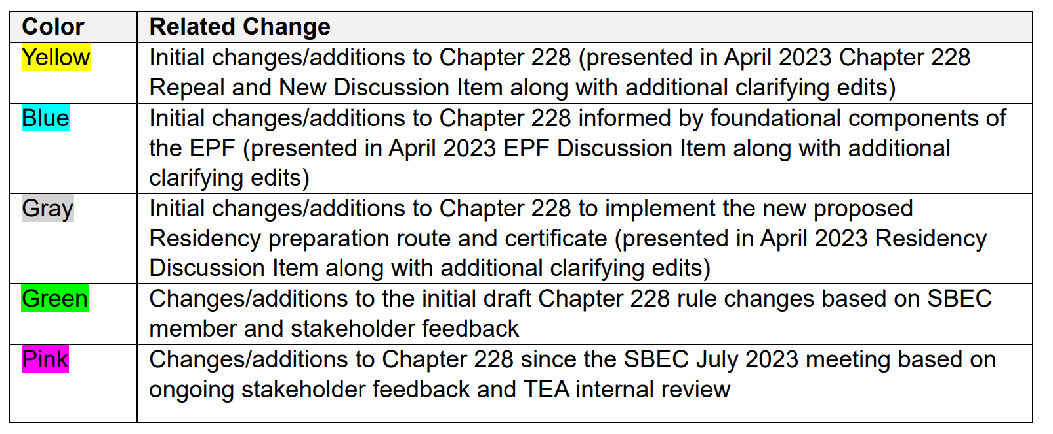
Tracking Updates to Chapter 228 Across the Year

Slide 10


Agenda for Today
Highlight Key Updates
Go to tea.texas.gov
OR
Ask Some Questions
About TEA > Laws & Rules > SBEC Rules (TAC) > Adopted Rules-Subject to SBOE Review
About TEA > State Board for Educator Certification > SBEC Meetings > February 16, 2024

Slide 11
Key Terms to Know for Today
Route = Undergraduate, Post Bac, Alternative, Residency
Class = Teacher, Principal, Superintendent, Educational Diagnostician, School Counselor, School Librarian, Reading Specialist
Non-teacher Class = All classes except Teacher
Clinical Experience = Clinical teaching, Residency, Internship, Practicum
FBE = early field-based experiences (pre-service requirements for Teacher candidates)
dba = Doing business as… (name used by an EPP other than the approved name)
Late Hire = Intern hired by a district and admitted into an EPP within the 45-day window before the first day of instruction or after school starts.
LEA = Local education agency (districts and their campuses)

Slide 12

Ask the Questions

Slide 13

Goals Outcomes
Improved Navigation
User Friendly
Added Definition
Clarified Vague Wording
Elevated Quality
Added Flexibility
Clarify Requirements for Non-teacher certificate classes
Stroll Through the Reorg

Slide 14
Navigation & Readability = Subchapters
General Guidance
Approval of EPPs
Administration & Governance of EPPs
Required Educator Coursework & Training
Educator Candidate Clinical Experiences
Support for Candidates During Required Clinical Experiences
Complaints & Investigations
A
B
C
D
E
F
G

Slide 15
Where 228 Updates Intersect with LEAs
Addition of Residency Route
Added Depth to Pre-Service Training through FBE
Supports for Candidates in Clinical Experiences
Requirements & Supports for Late Hire Interns

Slide 16
Addition of Residency Route
Addition of Residency Route

Slide 17
Residency – Key Updates (Support)
Residency: A full year clinical teaching experience in the classroom of a host teacher. Completion results in an Enhanced Standard certificate.
EPPs must apply and be approved by the SBEC.
Collaborative Agreement – EPP & LEA
Candidate assignment is full school year (first day-last day) on LEA campus with a minimum 750 hours / 21 hours per week
Residents must demonstrate mastery at 4 performance gates
Campus Host Teachers & EPP Field Supervisors provide support
Quarterly governance meetings with EPP and LEA leadership
Residency is optional and is not required of EPPs.

Slide 18
Added Depth to FBE
Added Depth to FBE

Slide 19
Definition-FBE
Field-based experiences (FBE) - Introductory experiences for a classroom teacher certification candidate, incorporated with preparation coursework that involve, at the minimum, reflective observation of and interaction with Early Childhood-Grade 12 students, teachers, and faculty/staff members engaging in educational activities in an authentic school setting.

Slide 20
FBE – Structure of Requirements
FBE completed pre-service (before clinical experience) (Existing)
Increases FBE requirement from 30 clock-hours to 50 clock-hours that are integrated into coursework. (Updated – Support/Flexibility)
  15 > 25 hours – active engagement in LEA classrooms
  15 > 25 hours – additional (active engagement or observation in LEA classrooms, technology-based, substitute teaching, educational aide assignment, service as teacher of record)
FBE must be completed during the school year and school day (Existing)
Add flexibility that allows FBE to be completed in summer school classrooms (New - Flexibility)
Experiences guided by EPP (Existing)
Candidates reflect on experiences. (Existing)

Slide 21
Supports for Candidates in Clinical Experiences
Supports for Candidates in Clinical Experiences

Slide 22
Definition - Clinical Experience
A supervised educator assignment through an EPP at a public school accredited by the TEA or other school approved by the TEA for this purpose where candidates demonstrate proficiency in the standards for the certificate sought and that may lead to completion of a standard certificate. Clinical experience includes clinical teaching, internship, practicum, and residency.

Slide 23
Clinical Experiences – Key Existing Requirements
Successful clinical experience is required.
Pre-service requirements for teacher candidates complete prior to clinical teaching or internship. (Existing)
Candidates must demonstrate proficiency in the certificate standards. (Existing)
Campus support & EPP field supervisors must meet qualification requirements & responsibilities. (Existing)
Campus support & EPP field supervisor must sign off that the clinical experience was successful (and provide a written reason for unsuccessful, as applicable) (Existing)
Candidates must hold an active Intern or Probationary certificate to complete an internship. (Existing)
An Intern/Probationary certificate must be deactivated when the candidate is no longer in the assignment (EPP must notify the LEA and candidate of the deactivation rules prior to the start of the internship). (Existing)
EPPs must maintain documentation as evidence these requirements have been met. (Existing)

Slide 24
Clinical Experiences – Key Updates
Adds the Residency & Defines requirements (New - Support)
Changes the duration of clinical teaching from 70 days to the equivalent of 490 hours (New - Flexibility)
Elevates quality of the clinical teaching experience by adding co-teaching and clarifying the candidate engages in increased instructional responsibility over the course of the assignment. (New/Clarified - Support)
Allows EPPs to extend clinical teaching for candidates who were unsuccessful in the first clinical teaching experience (New/Clarified - Support)
Requires the EPP to verify the Intern or Probationary certificate is active prior to the start of the internship. (New - Accountability)

Slide 25
Candidate Support Team – Key Existing Requirements
Candidates are assigned campus/district support and EPP field supervisor support. (Existing)
Campus support & EPP field supervisors must meet qualification & training requirements & responsibilities. (Existing)
Qualifications (Existing):
  Currently certified same as candidate;
  3+ years experience;
  accomplished educator as shown by student learning
Training: EPP must provide training to campus support (Existing)
  Includes training in coaching and mentoring
  Occurs within 3 weeks of assignment (Existing)
Training: EPP field supervisors must complete training (Existing)
Campus support & EPP field supervisor must sign off that the clinical experience was successful (and provide a written reason for unsuccessful, as applicable) (Existing)
EPPs must retain documentation as evidence of candidate support. (Existing)

Slide 26
Campus Support Team – Key Updates
Adds Host Teacher qualifications & responsibilities for the Residency route (New – Support)
Adds flexibility for training provided to campus personnel supporting candidates:
  during the 12 weeks before or three weeks after being assigned to the clinical teacher, intern, resident, or practicum candidate (Updated - Accountability)
EPP field supervisor must renew training every 3 years (New – Accountability)

Slide 27
Candidate Supports – Key Updates
Informal Observations conducted by EPP field supervisor:
Informed by candidate needs (Existing)
At least 3 times per semester, including coaching (Clarified – Support/Accountability)
First informal observation must be in person, remainder can be virtual/asynchronous (New – Flexibility)
Formal Observations conducted by EPP field supervisor:
45-minute minimum formal observation with POP cycle (Existing)
Clarifies EPP field supervisor communication with campus personnel (Clarifies – Support)
Increases minimum observations for clinical teachers from 3 to 4 (2 in first half of assignment, 2 in second half) (Updated – Support)
Increases the number of observations for candidates on Probationary certificates to equal the 5 required for candidates on Intern certificates (Updated – Support)
Moves the first intern observation to 4 weeks instead of 6 weeks
Up to 2 formal observations can be conducted virtually/asynchronously (Updated – Flexibility)
Adds observation requirements for Residency candidates (New – Support)

Slide 28
Requirements and Supports for Late Hire Interns
Requirements & Supports for Late Hire Interns

Slide 29
Late Hire Supports - Key Updates
Establishes early and more support from EPP field supervisors for Late Hire candidates through informal observations: (Updated – Support)
  3 informal observations/semester
  First 2 completed within the first 8 weeks of assignment
  First 2 must be in person
More support from EPP field supervisors for all candidates impacts late hire candidates: (Updated – Support)
  Added definition to expectations for EPP field supervisor collaboration with the campus personnel supporting candidates in clinical experiences.
  Moves the first intern observation to first 4 weeks instead of 6 weeks
Late Hire candidates must complete pre-service requirements within 90 days of assignment start date (Existing):
  Clarifies requirement for EPP to deactivate a certificate for a Late Hire who does not meet this requirement (Clarified – Accountability)

Slide 30
Additional Areas of Interest
Additional Areas of Interest

Slide 31
Additional Key Updates
Better Definitions for:
  School Day
  School Year
  Assignment Start Date
    First day of instruction with students: internship, clinical teaching, or residency
    First day of the window in which the candidate is authorized by the EPP to begin the practicum experience: nonteacher practicum
Adds instruction in implementing open education instructional materials to pre-service coursework requirements for Teacher Candidates.
EPP reports “dba” names annually to the SBEC. These will be made available to the public.
Implementation Date: September 1, 2024

Slide 32
Some Additional Questions Folks are Asking

Slide 33

Recommendations for LEA Partners
Continue to partner and engage with EPPs in the work of preparing future educators.
Continue to engage with trainings and informational webinars that will provide detail and build capacity around implementation of requirements in Chapter 228.
Continue to reach out to TEA staff if you have questions about updates in 228 or about requirements for educator candidate preparation. The Help Desk system is the recommended most efficient method for communication. Send inquiries to the Preparation Programs tile under Educator Testing and Preparation Programs. You’ll find the HD icon at top right on the tea.texas.gov landing page.

Slide 34
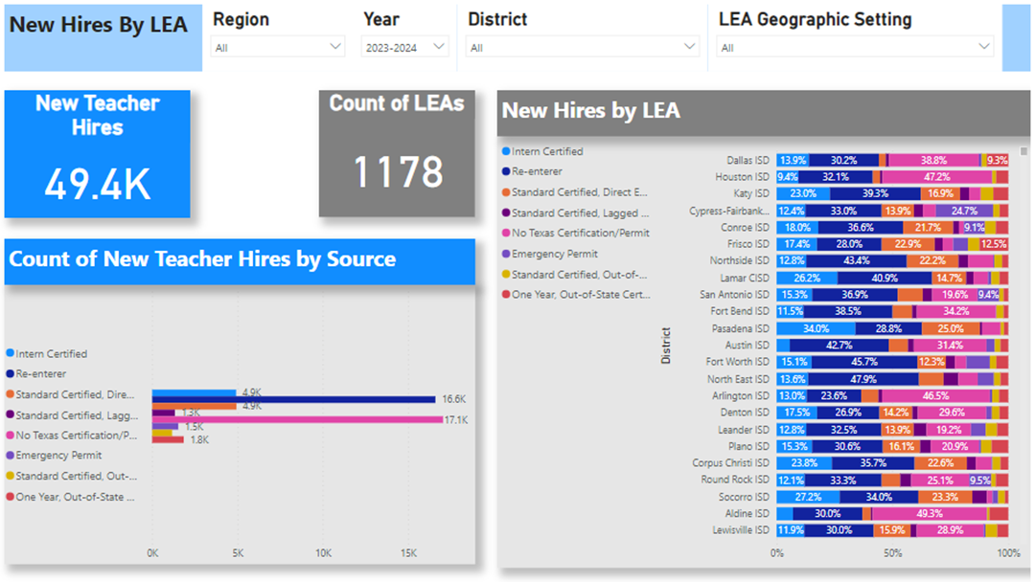
Learn More About the Data on Texas EPPs and District Hiring Trends
Links to statewide, EPP-specific, and district specific reports and dashboards:
Newly updated statewide reports and dashboards are available on our Educator Reports and Data page
Educator Preparation Program Accountability System (ASEP) results are available on our Educator Preparation Data Dashboard on the Consumer Information page
Newly Certified and Newly Hired Teacher Dashboards are a source for regional and local hiring information

Slide 35
Thank You for Attending!!

