Slide 1

Making the ELPS-TELPAS Connection
Grades K–12 Overview
Texas Education Agency
Student Assessment Division
Notes:
This presentation is designed to familiarize campus and district administrators and teachers with
the holistically rated components of TELPAS, and
how the Texas English Language Proficiency Standards (ELPS), in conjunction with TELPAS, support sound instructional practices for emergent bilingual (EB) students.
Three main types of training are provided by the TEA Student Assessment Division to support ELPS and TELPAS implementation. This presentation is the first type.
ELPS-TELPAS foundational training
Complements ELPS professional development training
Explains connection between ELPS and TELPAS
Provides thorough overview of how to use ELPS PLDs effectively in ongoing instruction and in spring TELPAS assessment
Good overview to provide in the fall of the year for administrators and for teachers who will become TELPAS raters in spring
TELPAS rater online training
Required spring holistic rating training for all teachers who rate EB students for TELPAS
TELPAS administration procedures training
Required annual test administration training for all district and campus personnel involved with TELPAS
Includes a recommended Web-based training course called Assembling and Verifying Grades 2–12 Writing Collections
This overview presentation sets the stage for the additional training presentations below, which are designed to help teachers use the PLDs formatively during instruction:
Introductory Training on the PLDs: Grades K–1
Introductory Training on the PLDs: Grades 2–12
These training presentations, which are recommended for use in the fall of the year, lay the foundation for web-based training of new raters in the spring.

Slide 2
Introduction
Notes:
For the purpose of this training PowerPoint, the term ‘emergent bilingual student’ is used; however, there has been no change to the term ‘English learner’ in the ELPS.
The term “EB/EL” is used in the Public Education Information Management System (PEIMS).

Slide 3
Session Objectives
To show the close connection between the Texas English Language Proficiency Standards (ELPS) and the Texas English Language Proficiency Assessment System (TELPAS)
To reinforce the benefits of using the ELPS to teach and assess emergent bilingual (EB) students effectively throughout the school year
To lay the foundation for the spring training of new TELPAS raters

Slide 4
Definitions
What are the ELPS?
  Federally required instructional standards designed to ensure that EB students are taught the academic English they need for school purposes.
What is TELPAS?
  A federally required assessment program designed to measure the annual progress that EB students make in learning the English language.
What are TELPAS raters?
  Educators trained to assess EB students in TELPAS holistic assessments.

Slide 5
Nuts and Bolts
The ELPS are used in foundation and enrichment instruction of K–12 EB students.
TELPAS assesses K–12 EB students. The ELPS and TELPAS encompass –
4 Language Domains
Listening Speaking Reading Writing
4 Proficiency levels
Beginning Intermediate Advanced Advanced High

Slide 6
Who Takes TELPAS?
All EB students in grades K–12, including those whose parents decline bilingual/English as a second language (ESL) program services, are assessed annually.
In extremely rare cases, an EB student served by special education may not be required to:
participate in one or more TELPAS language domains by the admission, review, and dismissal (ARD) committee in conjunction with the language proficiency assessment committee (LPAC), or
may be eligible to participate in TELPAS Alternate.
Notes:
In extremely rare cases, EB students with disabilities who receive special education services may not be required to:
participate in all or some components of TELPAS on a domain-by-domain basis as a result of a severe disabling condition, or
may be eligible to participate in TELPAS Alternate. The need for such a decision is rare. A student must be evaluated in all 4 language domains. There are no domain-specific exemptions.
The decision to administer TELPAS Alternate or to grant an ARD exemption in one or more domains in the general TELPAS is to be addressed by the LPAC and ARD committees prior to administering TELPAS and TELPAS Alternate and documented in the student’s individualized education program (IEP).
For EB students with the most significant cognitive disabilities, please refer to the TELPAS Alternate Resources webpage for more information on TELPAS Alternate eligibility and participation requirements.
For students in grades 2-12 who are unable to test online, the student may be eligible for a special administration based on their IEP or Section 504 paperwork. In these cases, students will be holistically rated in the domains of listening, speaking, and writing (as applicable). Students must have the same rater for all the applicable language domains. A paper test (regular print, large print, or braille) is the special administration for reading. For more information on a special administration of an online TELPAS test, refer to the District and Campus Coordinator Resources.

Slide 7
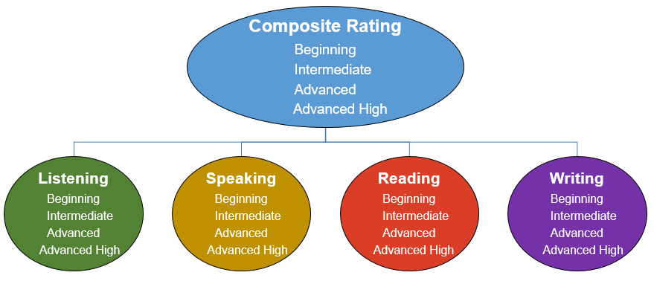
TELPAS provides proficiency level ratings for each language domain, plus an overall composite rating.
Notes:
The composite rating takes all language domains into account. The composite rating weights are 25% for each domain.
Listening 25%
Speaking 25%
Reading 25%
Writing 25%

Slide 8
Assessment Approaches
TELPAS uses online tests to assess
    2–12 listening, speaking, reading, and writing
TELPAS uses a holistic rating process and classroom performance to assess
    K–1 listening, speaking, reading, and writing
    2–12 listening, speaking, and writing (for special holistic administrations)
Notes:
Assessment timeline:
The holistically rated components of TELPAS were benchmarked in spring 2004 and fully implemented in spring 2005.
A multiple-choice test of English reading proficiency has been administered in Texas since 2000.
An online multiple-choice and technology enhanced test of English listening and speaking proficiency was first administered in Texas in spring 2018.
In spring 2023, a combined online reading and writing test for grades 2-12 was administered for the first time. For the reading component, the test will include multiple-choice items and technology enhanced items (TEIs); for the writing component, the test will include constructed response items and a variety of other items.

Slide 9
TELPAS Results
TELPAS results are used to —
set learning goals for EB students
keep parents and students aware of annual progress in learning English
inform instructional planning and bilingual/ESL program reclassification decisions
report performance to the public
evaluate programs, resources, and staffing patterns
evaluate districts and campuses in federal and state accountability and monitoring indicators

Slide 10
Brief ELPS Overview

Slide 11
English Language Proficiency Standards
Were approved by State Board of Education in 2007–2008
Are part of Texas Essential Knowledge and Skills (TEKS) state-required curriculum
Include instruction school districts must provide to give EB students full opportunity to learn English and succeed academically
Require content area teachers to teach content area TEKS and help EB students become English proficient
Are an integral part of instruction in each TEKS foundation and enrichment subject
Available on TEA’s Curriculum website
Notes:
The ELPS add to the content area TEKS and do not constitute a separate or substitute curriculum for EB students. Content area teachers provide instruction in both the grade-level content area TEKS and ELPS.

Slide 12
ELPS Components
Introduction Integrate second language instruction with content area instruction to make content comprehensible build academic language proficiency | Student Expectations for Second Language Acquisition Learning Strategies Listening Speaking Reading Writing
b) District Responsibilities Linguistically adjust instruction based on student proficiency levels Implement strategic interventions for beginning and intermediate students in grade 3 and up | Proficiency Level Descriptors for each Language Domain Beginning Intermediate Advanced Advanced High
Notes:
Section a) provides the rationale for the standards and their integration into all subjects of the foundation and enrichment curriculum.
Section b) sets forth the instructional framework, namely —
to know the student’s proficiency level and what each level means
to use that information to linguistically adjust content area instruction, with the dual goals of helping the student learn (1) the content area and (2) English
to intervene in especially intensive ways to accelerate the second language acquisition of students who are at the beginning or intermediate level in grade 3 and up
Section c) contains student expectations that specify what students need to learn to acquire a second language for academic purposes. The learning strategies maximize progress in the 4 language domains of listening, speaking, reading, and writing.
Section d) contains proficiency level descriptors (PLDs) that describe how well students communicate in English at each stage of acquisition, or proficiency level. The four proficiency levels are described for each language domain.

Slide 13
Example Student Expectation (SE) and Proficiency Level Descriptor (PLD)
What to learn – SE
Writing SE (G) – Narrate, describe, and explain with increasing specificity and detail to fulfill content area writing needs as more English is acquired
Stage of acquisition – PLD
Advanced writing (C)(IV) – Narrations, explanations, and descriptions developed in some detail with emerging clarity; quality or quantity declines when abstract ideas are expressed, academic demands are high, or low-frequency vocabulary is required
Notes:
This slide can be used to help show “in a nutshell” the relationship between the SEs and the PLDs.
The SEs are designed to be able to be effectively integrated into content area instruction by any content area teacher. They do not require a particular specialization in second language acquisition.
The PLDs describe the major features of each English language proficiency level within each language domain assessed.

Slide 14
ELPS-TELPAS Connection

Slide 15

TELPAS Measures the ELPS
The two are integrally aligned.

Slide 16
Measuring the ELPS
TELPAS assesses the abilities outlined in the
ELPS student expectations (SEs)
and reports performance in alignment with the
ELPS proficiency level descriptors (PLDs).
Notes:
For the holistic administrations of TELPAS, the SEs are not assessed in isolation. They are reflected holistically in the PLDs.
The online TELPAS listening and speaking test and the reading and writing test for grades 2–12 do not use a holistic approach. Each test question measures a specific SE.

Slide 17
PLDs and Instruction
Teachers should use the PLDs throughout the school year as
formative assessment rubrics to —
stay attuned to the English language proficiency levels of their students
monitor progress
linguistically tailor (accommodate) content area instruction and integrate second language instruction according to the proficiency level needs of their EB students as the students learn more English
Notes:
The PLDs are intended for use in ongoing instruction and should not be thought of as information to use just for TELPAS.
Section b) of the ELPS (district responsibilities) as well as the introduction to each language domain’s SEs in section c) require teachers to use knowledge of students’ English language proficiency levels to guide instruction.
The TELPAS PLDs are posted on the TELPAS Resources webpage.

Slide 18
PLDs and Statewide Assessment
For the TELPAS holistic assessments, trained raters officially determine the English language proficiency levels of EB students in the spring.
EB students should be making steady progress all year.
TELPAS is a summative assessment that documents the proficiency levels of EB students as a statewide spring assessment.
Notes:
Educators assigned to be the official TELPAS raters of EB students are trained to use the PLDs accurately and consistently statewide in holistic assessments.

Slide 19
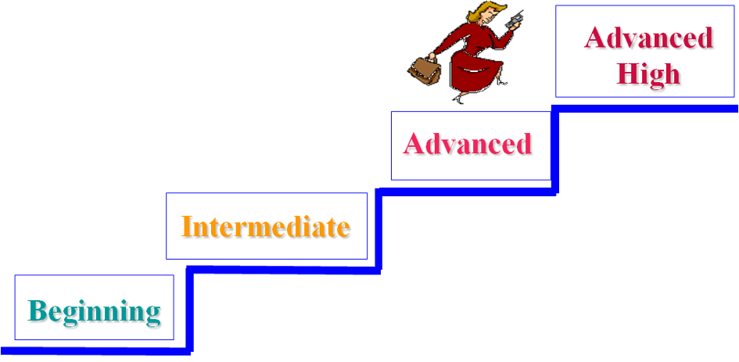
Summative TELPAS Assessment
TELPAS answers the following question:
How well is the student currently able to understand and use English during grade-level instruction?
Notes:
How well is the student currently able to understand and use English during grade-level instruction?
Teachers should clearly understand that this is the main question they are answering when they holistically assess students using the PLDs.

Slide 20
Benefit of TELPAS Rater Training on Formative Classroom Assessment
Teachers trained as TELPAS raters internalize the PLDs so that they are able to naturally and automatically assess their students’ English language proficiency levels during ongoing classroom instruction.

Slide 21
Benefit of Using PLDs in Instruction
Teachers learn to make effective linguistic accommodations in class, which supports
  learning of academic subject matter
  (TEKS content area student expectations)
  learning of English language
  (ELPS student expectations)

Slide 22
Reviewing the ELPS-TELPAS Connection
Teachers use the ELPS SEs and PLDs in instruction and for formative assessment all year.
TELPAS raters are trained in depth to learn to use the PLDs for the official purposes of statewide holistic assessments.
In-depth TELPAS rater training makes ongoing, formative use of the PLDs easy and serves the purpose of statewide holistic assessments.
For online TELPAS assessments in grades 2–12 (listening, speaking, reading, and writing), teachers should be trained and become familiar with the ELPS SEs and PLDs to incorporate in classroom instruction and use during formative assessment.

Slide 23
Assessment Information for Administrators and Teachers
To prepare for the new school year:
Use TELPAS results to evaluate whether students have been making steady progress in learning English.
    TELPAS confidential campus rosters include
      2 years of test scores
      how long the student has been in U.S. schools
LPAC meetings during school year:
Use previous spring’s TELPAS results and current year’s formative assessment results to gauge progress in English proficiency, plan for instructional interventions as needed, and inform spring decisions about student’s participation in state-required assessments.

Slide 24
Basics of TELPAS Holistic Rating Process

Slide 25
Grades K–1 Holistic Assessments: Listening, Speaking, Reading, Writing
Teachers determine English proficiency levels by observing students in class. They watch how their EB students
  interact informally with them and other students
  understand and use English
    when receiving academic instruction and completing class work
    during cooperative learning activities
Notes:
The formative assessment process works the same way during instruction throughout the school year.

Slide 26
Grades 2–12 Special Holistic Administrations: Listening and Speaking
Teachers determine English proficiency levels by observing students in class. They watch how their EB students
  interact informally with them and other students
  understand and use English
    when receiving academic instruction and completing classwork
    during cooperative learning activities
  Note: Grades 2–12 holistic assessments only apply for students that meet eligibility criteria for a special administration of an online TELPAS test.
Notes:
For more information on a special administration of an online test, refer to the District and Campus Coordinator Resources.
The TELPAS Paper and Holistic Test Administration Information should be used in conjunction with the TELPAS Rater Manual. Both resources are posted on the TELPAS Resources webpage.

Slide 27
Grades 2–12 Special Holistic Administration: Writing
Teachers assemble a collection of each student’s writing from a variety of content areas. Trained raters use the collection as the basis for evaluating the student’s English language proficiency in writing.
  Note that for ongoing formative assessment in grades 2–12, teachers use classroom observations and interactions in addition to student writing samples to monitor and promote growth in English language writing proficiency.
  For TELPAS, only the student writing collection is used when assessing English language writing proficiency. Information from classroom observations and interactions is not used.
  Note: Grades 2–12 holistic writing assessments only apply for students that meet eligibility criteria for a special administration of an online TELPAS test.
Notes:
Note that for ongoing formative assessment in grades 2-12, teachers use classroom observations and interactions in addition to student writing samples to monitor and promote growth in English language writing proficiency.
For TELPAS, only the student writing collection is used when assessing English language writing proficiency. Information from classroom observation and interactions is not used.
More information about the procedures for assembling TELPAS writing collections can be found in the following resources:
PowerPoint titled Grades 2–12 Writing Collection Overview on TEA’s TELPAS Resources webpage
The TELPAS Paper and Holistic Test Administration Information should be used in conjunction with the TELPAS Rater Manual. Both resources are posted on the TELPAS Resources webpage.
Online courses for Assembling and Verifying writing collections (available online in January)
Reminder: TELPAS raters of K–1 students base the rating of writing on classroom observation. Writing collections are optional for the K–1 grade levels.
For more information on a special administration of an online test, refer to the District and Campus Coordinator Resources.

Slide 28
Things to Know About TELPAS Rater Training and Administration Procedures

Slide 29
TELPAS Rater Training
It is recommended that districts and campuses determine in the fall who their TELPAS raters will be in the spring.
A training flowchart is provided on the next slide.
Notes:
Campus personnel should identify all EB students early in the school year and examine needs for new TELPAS raters.

Slide 30
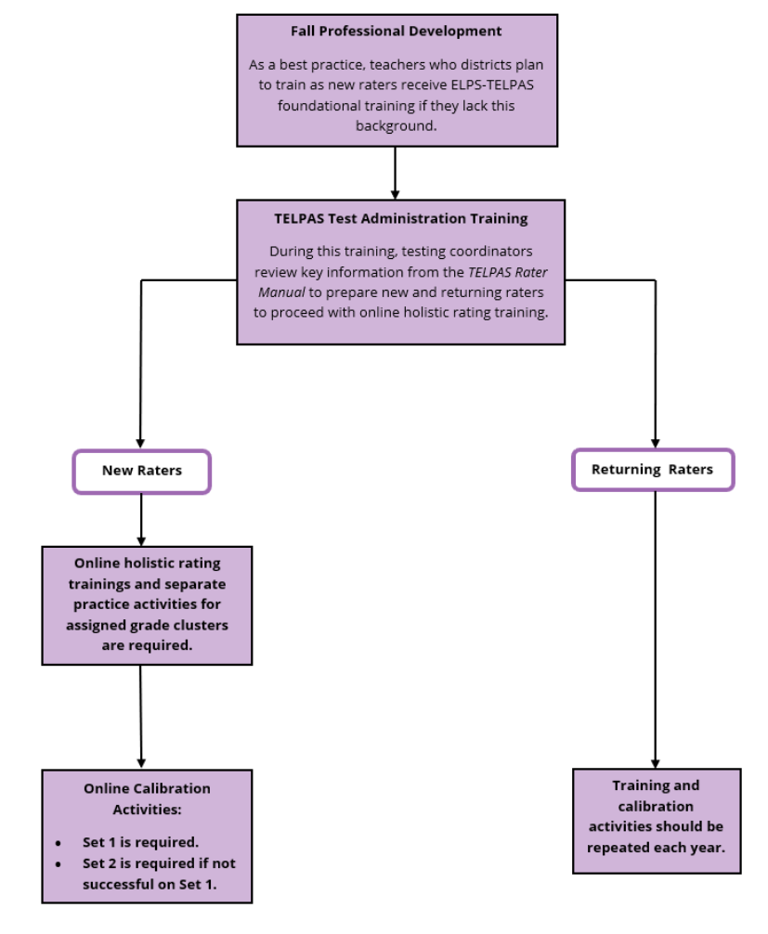
Holistic Rating Training Flowchart
The Holistic Rater Training Flowchart and additional information on rater training can be found in the TELPAS Rater Training section of the DCCR.
Information on holistic administrations* will be posted in the Holistic Administrations section of DCCR and in the TELPAS Test Administration Information (TAI), which is only available online.
Notes:
It is recommended that this PowerPoint presentation plus the Introductory Training on the PLDs slides (available from TEA’s TELPAS Resources webpage) be used in providing foundational ELPS-TELPAS training to teachers in the fall of the year. Spring training of teachers (who will be new TELPAS raters) will be a smoother process when they already have this foundation.
Summary of Spring Rater Training Process
In the spring, new raters in grades K-1 complete an online basic training course, which includes a training module for each language domain – listening, speaking, reading, and writing. There is one practice rating activity accompanying the training in which each language domain is represented.
For Special Holistic Administrations of Listening, Speaking, and/or Writing, new raters in grades 2-12 complete the online basic training course and a practice rating activity in the applicable domain/s (listening and speaking are one practice activity and writing is a separate practice activity).
All new raters complete calibration activities to ensure that they are prepared to apply the PLD rubrics consistently and accurately.
Returning raters have the option of reviewing the online basic training course, if desired, before completing calibration activities. Returning raters, who have successfully completed calibration activities at least once, are highly encouraged to complete calibration before rating; however, it’s optional, unless required by the campus testing coordinator.
There are two sets of calibration activities. For K-1 each set contains 10 students. Each language domain is represented in each set. For 2-12 writing, each set contains 10 writing collections. For 2-12 listening and speaking, each set contains 3 listening and 3 speaking student profiles. Raters successful on the first set do not calibrate further.
Only individuals who do not rate accurately enough on the first set will complete the second set.
Individuals not successful on the second set will either not be used as raters (a district decision) or will be provided rater support in accordance with test administration regulations.
More information about the Web-based TELPAS rater training process is available in the PowerPoint titled Holistic Rating Training Requirements which can be accessed from TEA’s TELPAS Resources webpage.

Slide 31
Rater Credentials
A teacher (including a substitute teacher) selected to rate an EB student must
have the student in class at the time of the spring assessment window,
be knowledgeable about the student’s ability to use English in instructional and informal settings,
hold valid Texas education credentials, such as a teacher certificate or permit,
be appropriately trained in the holistic rating process, and
rate the student in all eligible domains
Notes:
There is no longer a distinction between K-1 and 2-12 raters.
TELPAS raters may include:
Bilingual education teachers
English as a second language (ESL) teachers
Elementary general education teachers
Special education teachers
Gifted and talented teachers
Teachers of enrichment subjects
Substitute teachers
Paraprofessionals
Refer to the Rater Training section in the DCCR for additional information on paraprofessionals and non-certified staff serving as raters.
TELPAS ratings reflect the ability of students to understand and use English during content area instruction. Therefore, teachers who have EB students in content area classes are integral to the assessment.
Districts are encouraged to provide TELPAS rater training to as many new teachers as possible. TELPAS rater training helps teachers use the PLD component of the ELPS effectively.
Training more rather than fewer teachers also helps districts ensure that they can effectively meet TELPAS rating needs in the spring should there be unforeseen changes in student schedules or teaching assignments.

Slide 32
Collaboration with Others
In determining the proficiency ratings of their assigned students, raters are highly encouraged to collaborate with other teachers and school personnel who have knowledge of the students’ English proficiency.
Notes:
This type of communication and collaboration among teachers promotes discussions that lead to improved instructional strategies for EB students. To maximize student learning, teachers should engage in this type of collaboration at regular intervals during the school year.
At the time of the spring TELPAS administration, collaboration among teachers helps ensure rating accuracy. Collaboration is particularly important when a student has different content area teachers and/or is near the border between two proficiency levels. After collaborating with other teachers, the official rater is responsible for assigning the ratings.
.

Slide 33
District Validity and Reliability Procedures
Districts are required to implement procedures that ensure validity and reliability of the holistic rating process.
Procedures may vary by campus, at district’s discretion.
For one year from the date of testing, campuses maintain documentation of procedures followed.

Slide 34
TELPAS Audits
The Texas Education Agency conducts periodic audits of the TELPAS holistic assessment process. The goals of the audits are to examine whether
  the ratings reflect appropriate and consistent application of the PLD rubrics, and
  school district personnel follow training and test administration procedures.
Notes:
District and campus personnel selected for TELPAS audits are required to complete audit questionnaires and submit domain-specific assessment information to the testing contractor.

Slide 35
Essentials of Second Language Acquisition
Notes:
District and campus administrators, as well as teachers, should understand the essentials of the second language acquisition process.

Slide 36
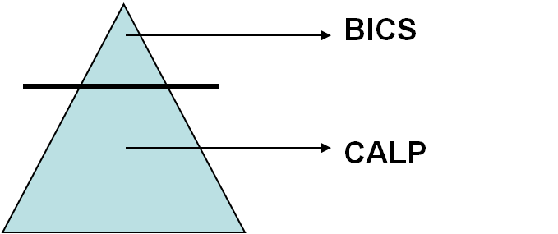
Understanding Language Proficiency in Social and Academic Settings
BICS: Basic Interpersonal Communicative Skills
CALP: Cognitive Academic Language Proficiency
Notes:
In 1981, Canadian professor and researcher, Jim Cummins, introduced these terms. The triangular graphic represents his “iceberg” model and shows two types of language proficiency: social (the visible portion above the water’s surface) and academic (the submerged portion).
Both types of language proficiency are important for academic success. Students must be able to understand and use the English of everyday social and routine classroom interactions as well as the English they need for accessing and negotiating learning, processing cognitively demanding information, and building conceptual understanding.
BICS: Everyday language needed for daily social interactions
BICS are acquired more quickly than CALP and are often easy to observe. Examples of BICS:
Listening and Speaking: Highly routine classroom interactions; discourse among friends in the hallway between classes, at recess, at lunch, on the school bus, on the telephone, at the mall, etc.
Reading and Writing: Reading a note from a friend; composing/reading casual letters and e-mails; reading bulletin boards, announcements, and other environmental print; writing lists; etc.
CALP: Language needed to access learning in academic settings
This is the language students need in order to think critically, understand and learn new concepts, process complex academic material, and interact and communicate in academic contexts. This part of the “iceberg” has more depth because this type of language proficiency takes longer to acquire. Examples of CALP:
Listening and Speaking: Participating in class discussions; listening to presentations; understanding language used in cognitively demanding explanations; presenting results of science experiments and observations
Reading and Writing: Reading a book or article to gain information; writing an essay or story; building conceptual knowledge through reading classroom materials

Slide 37
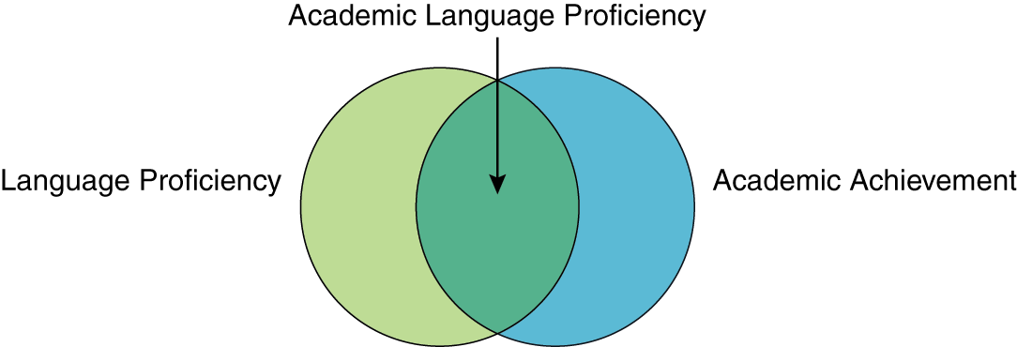
The Argument for Academic English Language Proficiency
Notes:
There is a distinction between language proficiency as a whole, academic achievement as a whole, and the overlapping section―academic language proficiency. Academic language proficiency is not the same as academic achievement but is an essential enabling component of academic achievement. EB students who have academic language proficiency understand the English that makes the learning of academic concepts and skills fully accessible. Academic language proficiency, therefore, provides the foundation for and access to academic achievement (though conceptual knowledge and skills, not just academic language proficiency, are necessary for academic achievement). Language proficiency encompasses both social language proficiency and academic language proficiency.
Social Language Proficiency
Language of social interaction
Language acquisition often outside of school
Tied to everyday life
Grounded in language proficiency standards
Academic Language Proficiency
Language of content-based instruction
Language acquisition mainly within school
Tied to school life
Grounded in language proficiency standards
Academic Achievement
Concepts of content-based instruction
Conceptual development
Tied to curriculum in specific content areas
Grounded in academic content standards

Slide 38
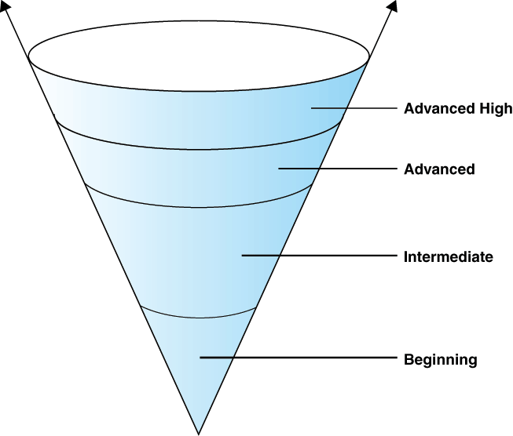
Building English Language Proficiency: A Cumulative Process
Notes:
This graphic illustrates that second language learning is a cumulative, spiraling, building process. The language skills associated with a given level are prerequisite to the broader range of skills at the next level. The arrows indicate that language continues to develop beyond the advanced high level. This level is not intended to be equal to the English language proficiency of a student whose first language is English. Over time, advanced high EB students understand finer nuances of English meaning, use more natural phrasing, and learn low-frequency words, idioms, sayings, etc., that are typically familiar to individuals whose first language is English.
Rates of progress. Students move through the proficiency levels at different rates depending on factors such as age, language facility, and instructional variables. Some students progress more quickly in certain domains than others (e.g., some students may progress more quickly in speaking than writing). In addition, students may move through certain levels more quickly or slowly than other levels. Without appropriate instruction, for example, some second language learners may experience a “plateau” at the intermediate or advanced level. These students need carefully targeted linguistic support to help them attain the level of English they need to make the learning of academic concepts easier.
Early and late stages. Each proficiency level encompasses a range of growth and has an early, middle, and late stage. Students in the later stages of a level demonstrate language features that “peak” into the next level. Students in the early stages of a new level occasionally demonstrate language features that “spike down” to the previous level. Raters should not classify a student in a level unless the student now performs most consistently at that level. When a student is near the border between two levels, raters need to determine at which level the student performs most consistently.
Advanced high. EB students at this level need only minimal support specific to second language acquisition. They know enough academic English to use the English language as an effective medium for learning academic material, with minimal second language acquisition support, in regular English instructional settings.

Slide 39
Linguistic Domains
Listening: the ability to understand spoken language, comprehend and extract information, and follow social and instructional discourse through which information is provided
Speaking: the ability to use spoken language appropriately and effectively in learning activities and social interactions
Reading: the ability to comprehend and interpret written text at the grade-appropriate level
Writing: the ability to produce written text with content and format to fulfill grade-appropriate classroom assignments
Adapted from Alief ISD Language Proficiency Profile
Notes:
This slide shows what the four linguistic domains mean in relation to evaluating the English language development of EB students.
Note that the definitions are not tied to academic achievement but rather to the communication skills that second language learners need in order to use English as an effective medium for academic instruction at their grade levels.

Slide 40
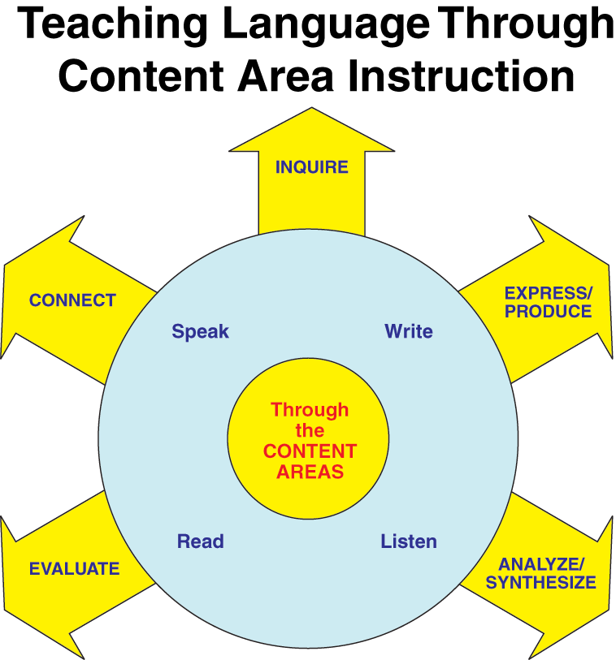
Teaching Language Through Content Area Instruction
Notes:
Communication skills in listening, speaking, reading, and writing are at the core of all academic learning.
As shown in the graphic, when content area teachers give EB students frequent, targeted practice in listening, speaking, reading, and writing in English, they build the English communication skills that enable EB students to develop and/or apply critical processing and thinking skills.
EB students need frequent opportunities to practice new English vocabulary and language structures. The ELPS student expectations make sure these needs are addressed.
Importance of Speaking and Writing: EB students internalize* the English they are exposed to much more readily when they actively practice and use language through speaking and writing activities. Having plenty of speaking and writing opportunities in content area instruction is beneficial for all students but is particularly important for EB students. It helps them not only learn the academic concepts of the content area but also internalize basic and academic English vocabulary. Teachers should not assume that EB students internalize language just by hearing it or seeing it in writing.
*Internalize in this context means making newly learned English “stick” as a permanent rather than temporary part of an EB student’s “bank” of English. EB students at the beginning and intermediate proficiency levels are bombarded with new language during daily instruction delivered in English. They cannot internalize everything they are exposed to. The language that sticks is language they frequently encounter, language presented in interesting and relevant contexts, and language they actively practice and use.

Slide 41
Summing Up

Slide 42
Ways ELPS and TELPAS Reinforce Quality Instruction
EB students use and practice their developing language.
Teachers collaborate about the needs of EB students.
Teachers use common vocabulary with one another and parents in
  describing language levels and needs of EB students, and
  setting goals for progress.
Notes:
Because of their English limitations, EB students are sometimes hesitant to participate in class and reluctant to try to express thoughts and ideas in English. Through the ELPS and TELPAS, teachers are encouraged to interact more with their EB students and give them frequent opportunities to use and practice their developing English.
Teachers of EB students have a better understanding that the way EB students communicate as they learn English is a natural part of second language acquisition. This helps teachers put students at ease, which, in turn, helps EB students feel less reluctant about taking risks and trying to express themselves in English.
When teachers collaborate, they learn from each other and share instructional strategies that help their EB students.
Some content area teachers may be accustomed to thinking only in terms of whether students are able to perform required grade-level academic skills. The ELPS and TELPAS help teachers also think in terms of how the language development of EB students affects their academic learning and how helping EB students with English supports their ability to achieve academically.

Slide 43
Ways ELPS and TELPAS Reinforce Quality Instruction (Continued)
Teachers understand the stages of learning English and how to get students from one proficiency level to the next.
Teachers learn to linguistically accommodate (communicate, sequence, and scaffold) instruction according to the English language proficiency levels of EB students.
EB students learn academic content more readily when they understand the language of their instruction.
Notes:
Linguistically accommodating instruction delivered in English means making it comprehensible to a student who struggles to understand the English language. Any student has difficulty learning challenging academic material when the language used in the instruction is “over their heads.” Using language at the level an EB student currently understands helps the student more effectively learn academic content taught in English.
Caution: Communicating with EB students only at their current level of understanding is not sufficient. Teachers must also make gradual and deliberate efforts to move students from their current level of English proficiency to higher levels. The PLDs give teachers a “road map” for doing this.
When teachers are successful in helping students reach higher proficiency levels, teachers and students both benefit.
Teachers benefit because they don’t need to make such extensive linguistic accommodations during instruction, which makes their job easier.
Students benefit because they become more proficient in English, which builds their confidence and makes it easier for them to learn academic material taught in English.

Slide 44
Bottom Line
Effective implementation of the ELPS and the TELPAS assessment throughout the school year helps EB students
  learn English more quickly, and
  grasp academic concepts and skills more readily.
Notes:
To continue with foundational ELPS-TELPAS training, you may wish to use the PowerPoint modules titled Introductory Training on the PLDs, Grades 2–12 or Introductory Training on the PLDs, Grades K–1, and the publication titled TELPAS Educator Guide. These resources are available on TEA’s TELPAS Resources webpage.

Slide 45
Disclaimer
These slides have been prepared by the Student Assessment Division of the Texas Education Agency. You are encouraged to use them for local training.
If any of the slides are changed for local use, please hide or remove any TEA logos, headers, or footers. (You may need to edit the Master slide.)

