Slide 1
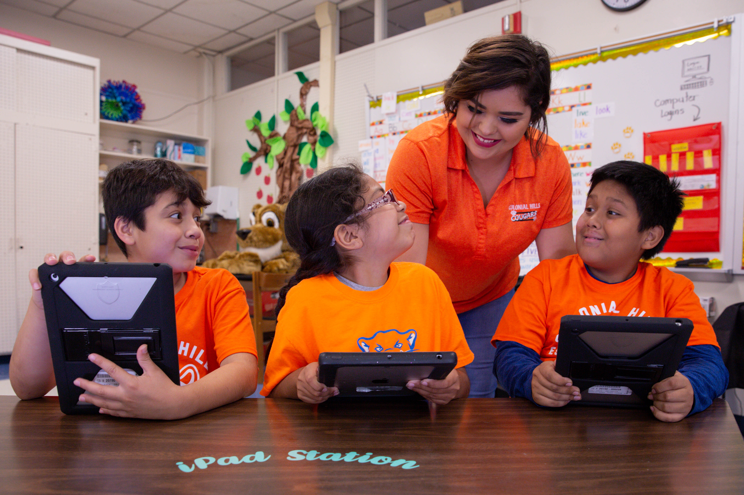

Introduction to TELPAS Alternate

Slide 2
Purpose of this TELPAS Alternate Training
Intended for any individual who needs a general overview of TELPAS Alternate
  Can be used as one of several training PowerPoints for test coordinators and test administrators
  Can be shown to administrators or parents who need to have a basic understanding of TELPAS Alternate
Describes the TELPAS Alternate assessment and the reason for its development
Provides a definition of the students in this special population
Outlines a schedule of events and additional training resources

Slide 3
TELPAS Alternate
The Every Student Succeeds Act (ESSA), requires each state to administer an alternate English language proficiency (ELP) assessment for emergent bilingual (EB) students with the most significant cognitive disabilities who cannot participate in the general ELP assessment, even with allowable accommodations.
The Texas Education Agency (TEA) worked with stakeholders to develop the TELPAS Alternate to evaluate grades 2-12 students receiving special education services identified in the Public Education Information Management System (PEIMS) as an EB student and also identified with a most significant cognitive disability.

Slide 4

What is TELPAS Alternate?
A holistic inventory that assesses the language domains of listening, speaking, reading, and writing for EB students with the most significant cognitive disabilities in grades 2-12
Aligned to the Texas English Language Proficiency Standards (ELPS)
Based on alternate Proficiency Level Descriptors (PLDs) created to address the specific access needs of this population

Slide 5
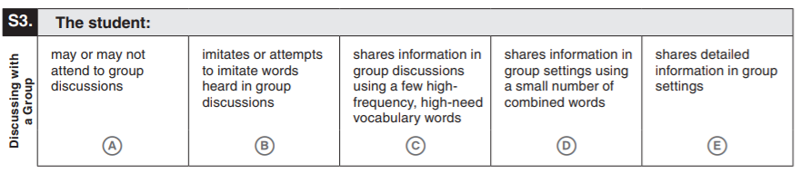
Observable Behaviors
The “test questions” in TELPAS Alternate are called observable behaviors. They are descriptions of student behaviors in the language domains of listening, speaking, reading, and writing. Test administrators consider how well students understand and use English in a variety of social and academic situations.

Slide 6
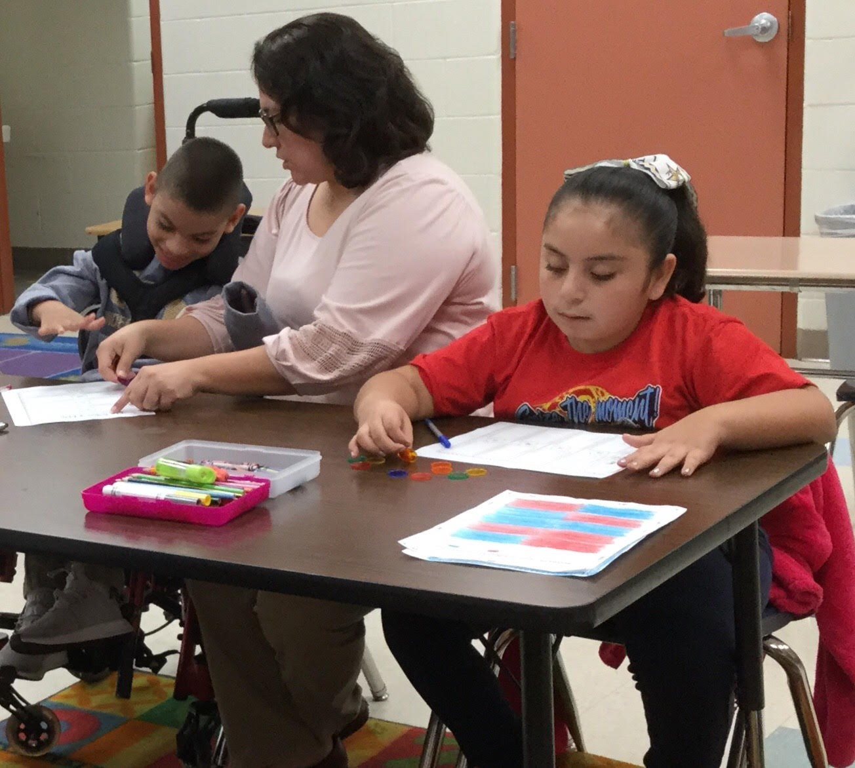
Who takes TELPAS Alternate?
Students taking TELPAS Alternate are EB students in grades 2-12 who have the most significant cognitive disabilities and who are in the process of acquiring English proficiency in listening, speaking, reading, and writing.
EB students, whose parents have declined bilingual or English as a Second Language (ESL) program services, are also required to be assessed with either TELPAS or TELPAS Alternate.

Slide 7
TEA Definition of Student with a Most Significant Cognitive Disability
A student with the most significant cognitive disability:
Exhibits significant intellectual and adaptive behavior deficits in their ability to plan, comprehend, and reason, and who also indicates adaptive behavior deficits that limit his or her ability to apply social and practical skills (e.g., personal care, social problem-solving skills, dressing, eating, using money) across all life domains.
Requires extensive, direct, individualized instruction and needs substantial supports that are neither temporary nor specific to a particular content area.

Slide 8
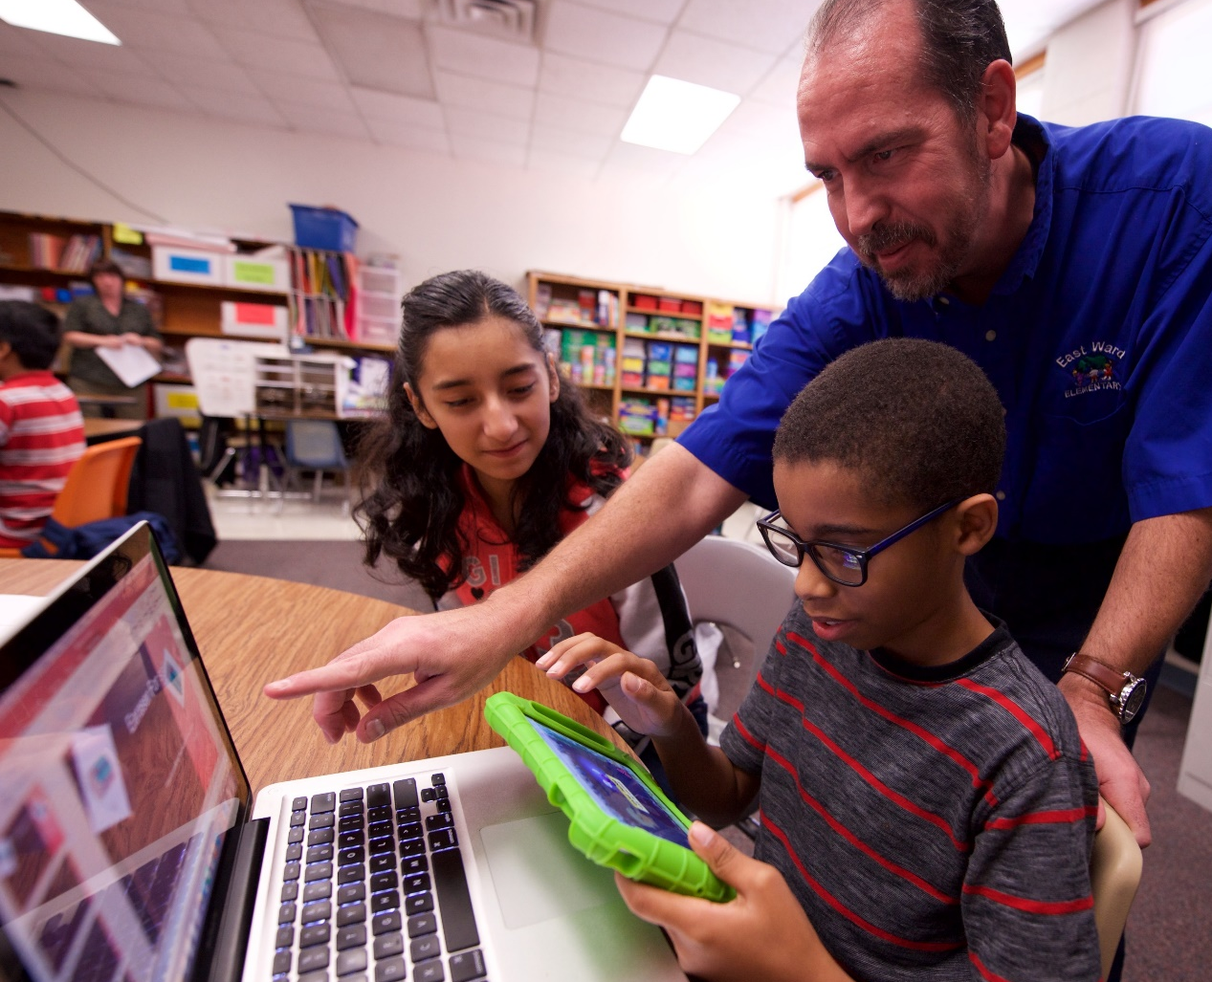
Alternate Response Modes
For TELPAS Alternate, "English" is more inclusive to allow for all modes of communication in English.
Some EB students use sign language, braille, or another method of communication as a substitute for traditional English in one or more language domains.
Teachers should take into account whether an alternate response mode is an appropriate way for an individual student to demonstrate English proficiency in a specific language domain.

Slide 9
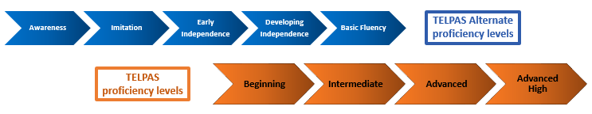
TELPAS Alternate Proficiency Level Labels
For each language domain, TELPAS Alternate measures five levels, or stages, of increasing English language proficiency versus the four levels in TELPAS (the general English language proficiency assessment).
Some TELPAS Alternate proficiency levels overlap some of the TELPAS proficiency levels.
By stretching out the Beginning and Intermediate levels of TELPAS, TELPAS Alternate provides more granular information about English language proficiency for students with significant cognitive disabilities. This can help educators more specifically assess growth and target instruction from year to year.

Slide 10
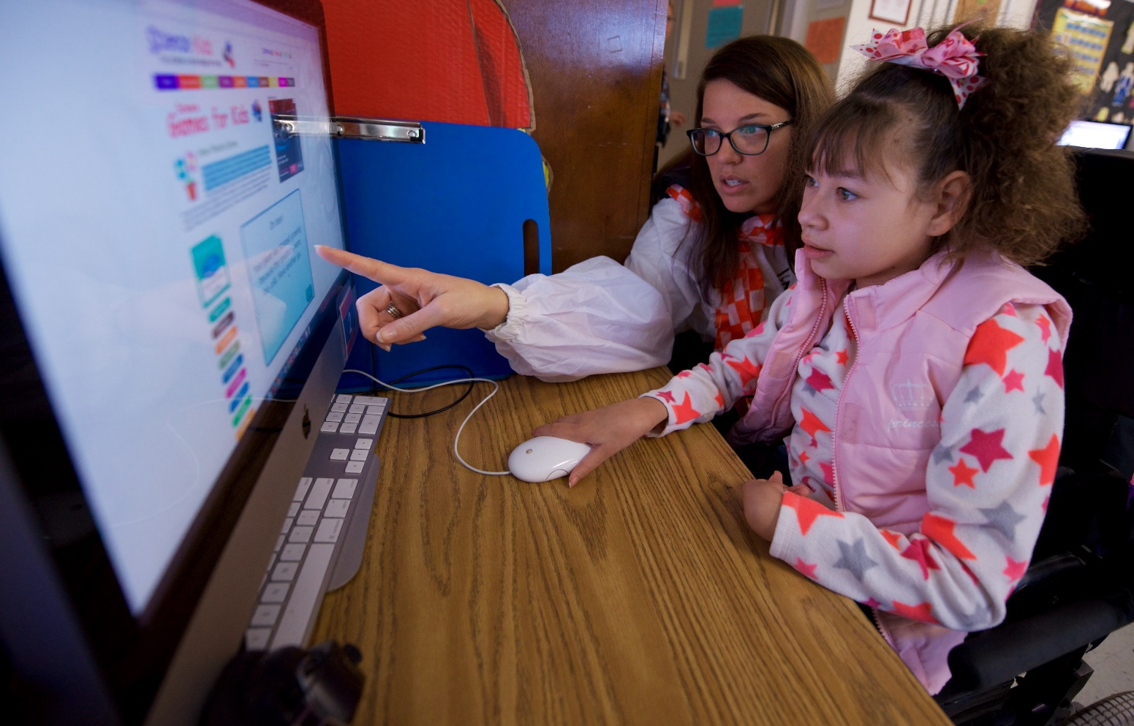
TELPAS Alternate Proficiency Level Global Definitions
Global definitions provide a common definition of the characteristics specific to each proficiency level across all four language domains and explain what it means for a student to be classified as: Awareness, Imitation, Early Independence, Developing Independence, or Basic Fluency.
Understanding the global definitions and features provides the foundation for understanding the language acquisition skills students possess at each proficiency level.

Slide 11
TELPAS Alternate Proficiency Level Labels and Global Definitions
Proficiency Level Label | Global Definition
Awareness | Students who receive this rating may be aware of English sounds or print; however, they have little or no functional ability to participate in communication activities in English.
Imitation | Students who receive this rating match, imitate, or approximate some English in their environment; however, they are not able to independently understand or produce English. They participate in routine communication activities in a familiar environment when the activities are significantly linguistically accommodated.
Early Independence | Students who receive this rating understand short, simple messages and produce messages of one or two high-need, high-frequency words (e.g., book, cafeteria, teacher). They are starting to participate in linguistically accommodated communication activities in English in familiar environments.
Developing Independence | Students who receive this rating understand longer messages of multiple sentences in English and produce simple, descriptive, original messages by combining two or more words (e.g., new red bike, big fast truck). They participate meaningfully in linguistically accommodated communication activities in English in familiar environments.
Basic Fluency | Students who receive this rating understand and produce more detailed, complex, and elaborate messages with multiple sentences in English. These students participate independently in communication activities in English in familiar environments.

Slide 12
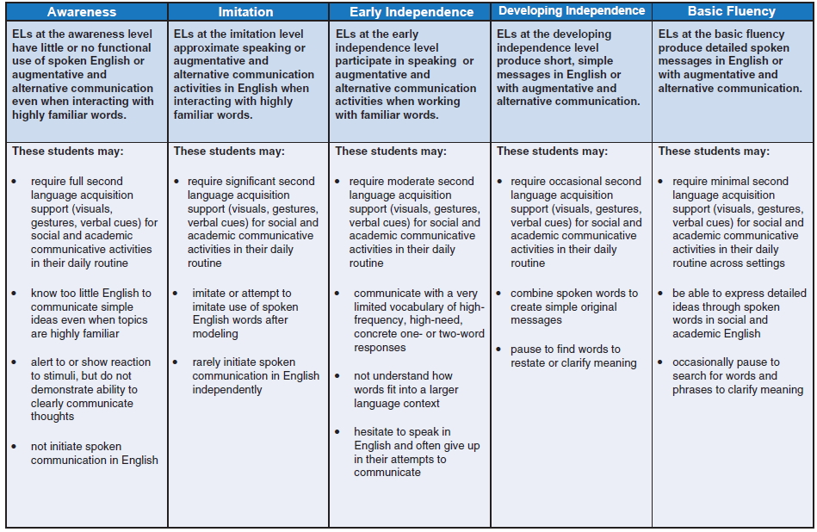
Alternate Proficiency Level Descriptors
While the global definitions from the previous slide apply across all four language domains, the alternate PLDs present the major characteristics of students who are classified at the Awareness, Imitation, Early Independence, Developing Independence, or Basic Fluency proficiency level for reading, writing, speaking, and listening.
The PLDs are domain-specific and define how well EB students at the five proficiency levels are able to understand and use English in social and academic settings.
The descriptors show the progression of second language acquisition from one proficiency level to the next and serve as a road map to help teachers tailor instruction to the linguistic needs of EB students.
They provide a common framework for understanding the language acquisition skills needed to be classified within each proficiency level.

Slide 13
TELPAS Alternate Test Blueprint Development
TELPAS organizes the majority of the ELPS student expectations under several reporting categories, or skill areas, on the test blueprints.
In order to create the TELPAS Alternate test blueprints, educators from around the state reviewed the ELPS student expectations and determined those most accessible and assessable for EB students with the most significant cognitive disabilities.
These student expectations were then organized under the same reporting categories as TELPAS; however, the blueprints are not identical.
  TELPAS contains more test questions than TELPAS Alternate.
  Some student expectations were deemed not accessible and therefore not assessable for students with the most significant cognitive disabilities.
TELPAS Alternate test blueprints illustrate the number of observable behaviors assessed in each reporting category with a total test length of 10 observable behaviors per language domain.

Slide 14
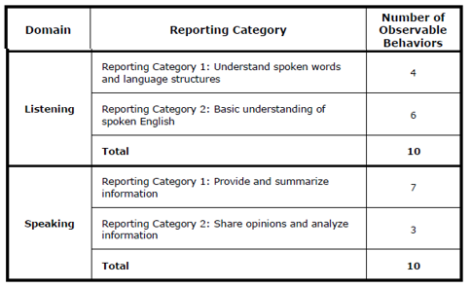
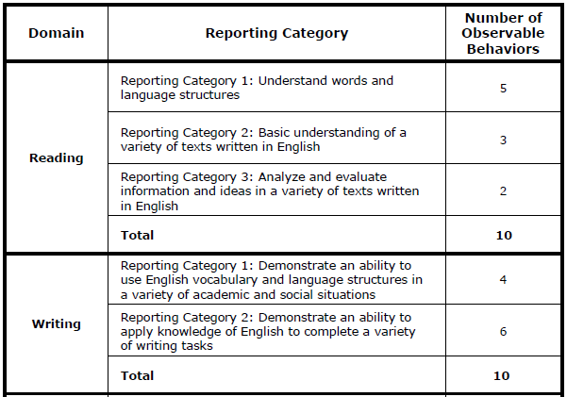
TELPAS Alternate Test Blueprints

Slide 15
Process for Considering Reclassification of EB Students with Special Needs
For questions regarding reclassification:
Bilingual and English as a Second Language Education Programs webpage
Division of Emergent Bilingual Support:
512-463-9414
EmergentBilingualSupport@tea.texas.gov

Slide 16


Schedule of Events
Districts receive TELPAS Alternate manuals and materials
Preliminary TELPAS Alternate reports posted
TELPAS Alternate webinar
TELPAS Alternate materials posted
Required TELPAS Alternate training sessions
TELPAS Alternate administration window
Final TELPAS Alternate reports posted
For specific dates for each of these events please consult the Texas Student Assessment Program Calendar of Events in the DCCR.

Slide 17
TELPAS Alternate Training Resources
Resource | Purpose | Audience
TELPAS Alternate Educator Guide | Provides an overview of TELPAS and TELPAS Alternate and serves to support effective implementation of the ELPS | Administrators, Coordinators, Teachers
Participation Requirements | Used by ARD committees in conjunction with the LPAC to make decisions about TELPAS Alternate | Members of ARD committees and LPACs
Test Administration Manual | Contains instructions covering the responsibilities of test administrators and the observable behaviors used to assess students Required to be read carefully and followed as written | Administrators, Coordinators, Teachers serving as test administrators

Slide 18
TELPAS Alternate Training Resources (continued)
Resource | Purpose | Audience
Training PowerPoints (See list on next slide) | Provides training on a variety of topics, including authentic classroom activities for each domain that explain how to rate students with the observable behaviors Designed as short PowerPoints that can be viewed in 10-15 minutes Are optional though highly recommended | Administrators, Coordinators, Teachers serving as test administrators
Online TELPAS Alternate Training Modules | Are online TELPAS Alternate training modules that are broken into two parts with each one having 4 modules. The training modules are available at the Texas Assessment Learning Management System. | Administrators, Coordinators, Teachers serving as test administrators

Slide 19

Available TELPAS Alternate Training PowerPoints
Introduction to TELPAS Alternate
Student Eligibility
Speaking Domain
Listening Domain
Reading Domain
Writing Domain
Accessibility
Test Administration

Slide 20
Contact Information
TEA’s Student Assessment Division
512-463-9536
Help Desk
Helpdesk.tea.texas.gov
Texas Testing Support
833-601-8821
TexasTestingSupport@cambiumassessment.com.

Slide 21
Disclaimer
These slides have been prepared by the Student Assessment Division of the Texas Education Agency. You are encouraged to use them for local training.
If any of the slides are changed for local use, please hide or remove any TEA logos, headers, or footers. (You may need to edit the Master slide.) In addition, you must remove the photographs. Only TEA has parental permission to use these photographs for training purposes.
This training is not intended to replace any materials or additional information on the TEA website.

