Slide 1
State Funding Update
Texas Education Agency
October 2017

Slide 2
Agenda
TEASE Access for the FSP System
Summary of Finances and Payment Cycle Update
  Closing out 2016-2017
  Updates to 2017-2018
Property Value Growth and Decline and financial hardship grants
Chapter 41 Wealth Equalization
Other Legislative changes from 85th leg.

Slide 3
TEASE Access for the FSP System

Slide 4
FSP Modules
Attendance Projections
Bond Programs
Chapter 41
Charter Schools
NIFA
Staff Salary
State Compensatory Education
Tax Information Survey
Transportation

Slide 5
TEASE Access for the FSP System
Data submitted through this system affect state aid payments and recapture requirements
The modules are set up to include multiple roles: user and approver
The TEA does not use data until it has been approved by the district approver and has been submitted to TEA
We do not recommend that the user and approver be the same person
We do recommend:
  Checking TEASE access periodically to be sure that current staff are included and staff that no longer work with the district are not included
  Making sure that major submissions are completed and approved on time

Slide 6
TEASE Deadlines
Attendance Projections: October through December of even numbered years
Transportation:
  Route Services Report: August 1
  Operations Report: December 1
Tax Information Survey: End of August
Staff Salary: August for Near Final and April for Final

Slide 7
TEASE
TEA had been automatically adding all the roles district approvers (superintendents) need
We had an audit finding and this will no longer be possible
We will publish a list of all the roles and district staff will have to apply for them all

Slide 8
Status of Foundation School Program Payment Cycle

Slide 9
Closing out 2016-2017

Slide 10
Near Final Settle Up (2016–2017)
Near Final summaries of finance (SOF) for the 2016–2017 school year were published 09/08. These incorporated:
  ADA and FTE counts from summer PEIMS
  Tax Collections estimates from the Tax collection
  Transportation module data
  Districts which have not submitted will have until final settle-up in April before allotments are zeroed out
  Staff salary data for districts who did not submit at near-final
  Districts which have not submitted will have until final settle-up in April before allotments are zeroed out
  IFA and EDA near final will be run in October

Slide 11
Near Final settle-Up
$428 million in negative adjustments were rolled to 2018
$575 million in Payments will be made late September
LPE ADA 5.02 million DPE 4.974 => 45,000 ADA down
Special ED., CTE, Bilingual all increased
WADA only 18,000 down
ASATR $415 million

Slide 12
Updates to 2017-2018

Slide 13
2017-2018 Funding Elements (LPE)
Basic allotment and equalized wealth level are ($5,140 and $514,000).
The guaranteed yield for the golden pennies is $99.41
Revised Available School Fund rate ($260.566)
New Instructional Facilities Allotments (NIFA) for approved applications
M&O tax Collections are 2016 PEIMS budgeted increased 7.04%
Attendance projections submitted by the district in October 2016

Slide 14
Compressed Tax Rate Adjustments
Apply tax effort above compressed tax rate + .06 to tier I instead of tier II level II
Are automatic from 2018 onward

Slide 15
2017-2018 Summary of Finances (LPE)
Total FSP state aid: $19.2 billion
Total ASF: $1.0 billion
Total EDA: $219 million
Total IFA: $190 million
Total Recapture $2.1 billion

Slide 16
Updates to 2017-2018 Summary of Finances (SOF)
Updates to SOF will include:
  February – Updated M&O tax rates from self report
  March – Updated DPE with PEIMS fall enrollment data and budgeted tax collections
  April – SCE counts
  June-August – Chapter 313 and supplemental TIF payments

Slide 17
Property Value Decline and Hardship Grants

Slide 18
Hardships caused by decreasing values
Districts with declining values are disadvantaged because the state uses prior year property values in calculating the local share of the FSP. In these cases, prior year values don’t fully reflect the decline and exaggerate the district’s ability to raise local tax revenue.
When making payments to districts during the fiscal year, the state is required to assume the same estimated percentage increase in property values for all districts.
Districts with declining values therefore experience significant under-payments which can negatively impact cash flow and overall funding levels.
1
2
3
18

Slide 19
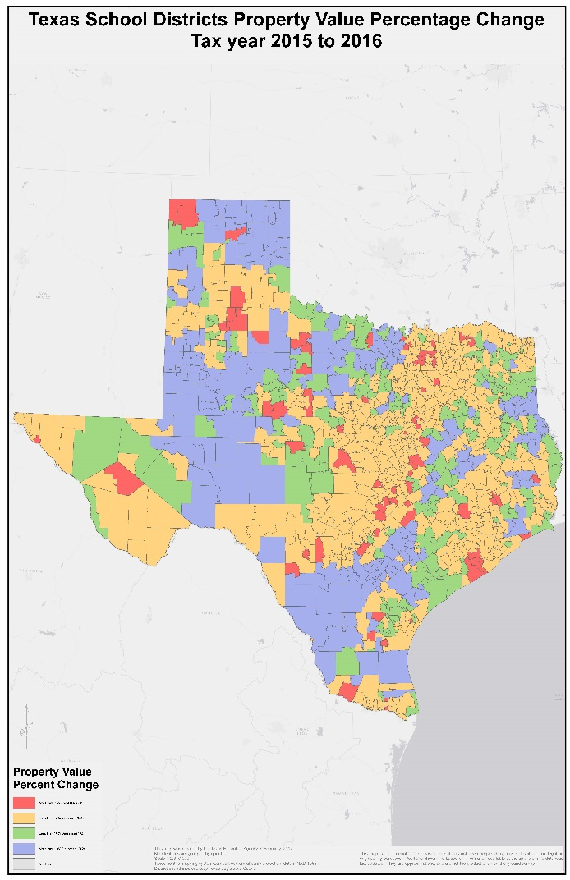
Districts with Rapidly declining property values: a statewide perspective
Districts marked in purple have
declining property values
Green is slowly declining
Districts marked in red and orange still have increasing values and include the major urban areas of the state
Overall the state still has increasing value
19

Slide 20
Property Value Decline adjustments
There is a provision in the TEC 42.2521(a) that provides for assistance for rapid property value decline, this provision requires an appropriation
For the 2017-2018 biennium, the legislature appropriated $50 million for fiscal year 2018 and $25 million for fiscal 2019

Slide 21
Adjustment for rapid property value decline
2018 $50 million appropriated for value decline in excess of 4%
For fiscal 2018 The decline addressed is from TY 2015 -> TY 2016 on 2017 SOF
All eligible districts had their property values adjusted, the SOFs rerun and a prorated amount added to “other programs detail report”.

Slide 22
Financial Hardship Grants
Compare 2018 current law ($99.41 tier II, level I and no ASATR) to 2018 prior law ($77.53 tier II level I and ASATR)
$155 million in total losses
$100 million available in 2018
LPE estimates used, payments made in October
Districts cannot get both Hardship and decline. TEA made best choice.

Slide 23
Chapter 41 Update

Slide 24
2018 Chapter 41 Update
427 districts were notified of Chapter 41 status
  Districts with an EWL > $319,500 are identified as Chapter 41 and must tell the TEA how they intend to equalize wealth
Final Chapter 41 designations will be made after we receive final values and decisions regarding whether districts charge tuition
Total estimated recapture for 2017–2018 is $2.1 billion
Intent and choice selection and contract process is now online
Not all districts that are identified as Chapter 41 owe recapture

Slide 25
Chapter 41 Process
Final notification mid-July
Intent and Choice Selection Due Sept 1
Options and Contracts Due Jan 15
Preliminary Payment Report: Published at the end of January
  Incorporates data estimates submitted by districts through the Chapter 41 module in the FSP system in TEASE
  Option 3 payment schedule for payments submitted February through August

Slide 26
How is recapture revenue used by the State?
The most commonly chosen method of paying recapture is Option 3 (paying directly to the State).
Payments are made in seven equal installments from February through August of every fiscal year.
Funds received by the state from recapture, which are estimated to total $2.07 billion in FY2018, are appropriated in the General Appropriations Act to pay for the Foundation School Program (FSP).

Slide 28
All unexpended balances and all funds received from the payment of school districts for attendance credits in excess of the amounts appropriated above pursuant to the provisions of §41.094 of the Texas Education Code, are hereby appropriated to the Texas Education Agency for distribution to school districts for Foundation School Program purposes.

Slide 29
Recapture 2007-2018

Slide 30
Other Legislative Changes

Slide 31
House Bill 21
$100 million hardship grants in 2018, $50 million in 2019
Dyslexia and Autism grants for selected LEAs (10 selected for each grant). $10 million for each grant for each year
2019 EDA increase for school districts $37.30 ($60 million)
EDA for charter schools $200 per ADA ($60 million)

Slide 32
HB21
All small districts funded on 300 square mile factor (5 year phase in beginning in 2019)
Year | Small district adjustment Factor
2019 | .000275
2020 | .0003
2021 | .000325
2022 | .00035
2023 | .0004

Slide 33
HB21 Commission on public school finance
Commission on Public school finance
Recommendations:
  Appropriate levels of local funding
  Purpose of the system
  Policy changes to adjust for student demographics and geographic diversity
  Report due Dec 31 2018

Slide 34
Other school finance legislation
SB195 High risk of violence hazardous mileage and walking routes for transportation
SB1882 District charter campuses funded like they are charter schools
SB3593 technology applications courses in cybersecurity eligible for CTE funding
HB1081 NIFA – $1,000 per ADA. Re-purposed and leased facilities eligible

Slide 35
Other school finance legislation
SB1480
Increases BGP capacity for charter schools
Increased by 20% each year – will be +- 2 Billion ?
Guaranteed bonds are not subtracted from capacity
Security interest to the state for any guaranteed properties
Increased contribution to charter school bond reserve fund

Slide 36
Hurricane Harvey Adjustments
TAA letter October 9th
Districts and charter schools losing ADA as a result of Hurricane Harvey will be held harmless to their 3 year average attendance projection at near final
Eligibility:
The school district or charter school has had damage to at least one campus which has resulted in a disruption of instruction lasting 2 or more weeks, OR
The school district or charter school had instructional facilities that were closed for the 9 or 10 hurricane related waiver days, and
The school district or charter school must complete the Governor’s Commission to Rebuild Texas Worksheet by October 27, 2017.

Slide 37
Contact Information
Al McKenzie
Director, State Funding
Al.McKenzie@tea.texas.gov
(512) 463-9186

